Slide 1

MBEYA UNIVERSITY OF SCIENCE AND TECHNOLOGY
COLLEGE OF ELECTRONICS AND POWER ENGINEERING
(EPE)
Facilitator : Eng.PHILIPO MNAKA N.
COURSE : ET8203 CIRCUIT THEORY.
CREDITY : 7.0
COURSE STATUS : Core

Slide 2
Learning Outcomes;
Upon completion of this course, The student should be able to:
Analyze DC circuit at steady state using various methods and Techniques.
Analyze AC circuits at steady state using various methods and techniques .
Using Laplace transform technique to analyze AC circuit.
Calculate transient conditions of electrical circuit
Design general filter circuits using the concepts of frequency selective circuit

Slide 3
Assessment methods.
The course will be assessed through assignment, test, and end of semester examination.
Continuous Assessment involves 40%. and the End of the semester examination 60%.
Recommended References/Textbooks:
Alexander, Charles K. and Sadiku Matthew, N.O. (2013) ―Fundamentals of Electric Circuits
Nilsson, James W. (2015) ―Electric Circuits‖, 10Th Edition, Pearson, 2015, ISBN: 9780133760033
3. Chakraborty A K, Ghosh, S P,(2010) ―Network Analysis and Synthesis‖, 1St Edition, 2010, McGraw - Hill Education , SBN No.: 9780070144781

Slide 4
DC Circuit.
Introduction
Electric circuit theory and electromagnetic theory are the two fundamental theories upon which all branches of electrical engineering are built.
Many branches of electrical engineering, such as power, electric machines, control, electronics, communications, and instrumentation, are based on electric circuit theory.

Slide 5
In electrical engineering, we are often interested in communicating or transferring energy from one point to another.
To do this requires an interconnection of electrical devices.
Such interconnection is referred to as an electric circuit, and each component of the circuit is known as an element

Slide 6
So An electric circuit is an interconnection of several electrical elements that connected together in such a manner to perform a certain objectives and desired function.
By the analysis of a circuit, we mean a study of the behavior of the circuit:
How does it respond to a given input?
How do the interconnected elements and devices in the circuit interact?
So We commence our study by defining some basic concepts.

Slide 7
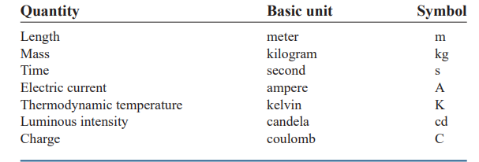
These concepts include charge, current, voltage, circuit elements, power, and energy. Before defining these concepts, we must first establish a system of units that we will use throughout the text as,

Slide 8
Charge
The most basic quantity in an electric circuit is the electric charge.
We all experience the effect of electric charge when we try to remove our wool sweater and have it stick to our body.
Charge is an electrical property of the atomic particles of which matter consists, measured in coulombs (C).

Slide 9
We also know that the charge e on an electron is negative and equal in magnitude to 1.602x10⁻¹⁹ C,
while a proton carries a positive charge of the same magnitude as the electron.
The presence of equal numbers of protons and electrons leaves an atom neutrally charged.
The following points should be noted about electric charge.

Slide 10
1. The coulomb is a large unit for charges. In 1 C of charge, there are electrons. Thus realistic or laboratory values of charges are on the order of pC, nC, etc.
2. According to experimental observations, the only charges that occur in nature are integral multiples of the electronic charge
3. The law of conservation of charge states that charge can neither be created nor destroyed, only transferred.
Thus the algebraic sum of the electric charges in a system does not change.

Slide 11
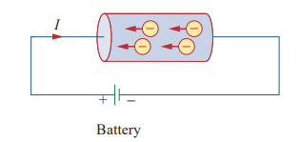
Flow of electric charges and current

Slide 12
Electric current.
Electric current is the time rate of change of charge, measured in amperes (A).
Note, any large power supply capacitor can store up to 0.5 C of charge.

Slide 13
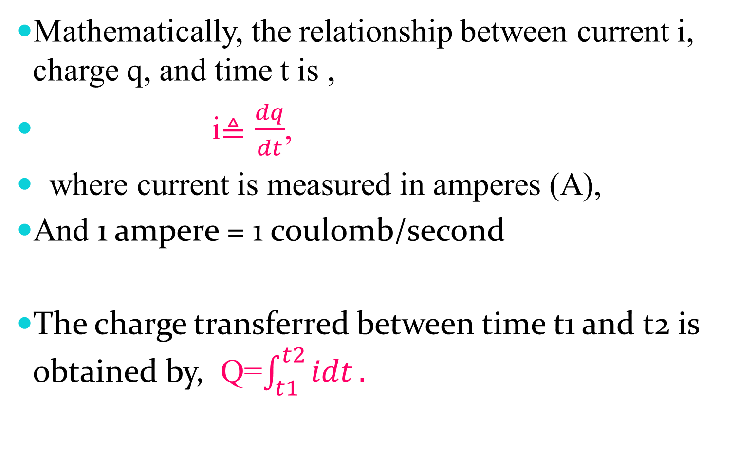
Mathematically, the relationship between current i, charge q, and time t is ,
i$≜\frac{dq}{dt}$,
where current is measured in amperes (A),
And 1 ampere = 1 coulomb/second
The charge transferred between time t1 and t2 is obtained by, Q=$\int_{t1}^{t2}{idt}.$

Slide 14
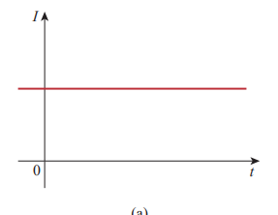
There are two common types of current which are: (a) direct current (dc), (b) alternating current (ac).
If the current does not change with time, but remains constant, we call it a direct current (dc). A direct current (dc) is a current that remains constant with time.

Slide 15
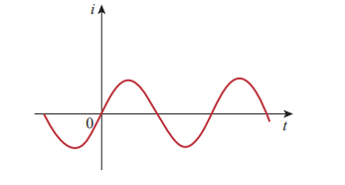
An alternating current (ac) is a current that varies sinusoidally with time.
Such current is used in your household, to run the air conditioner, refrigerator, washing machine, and other electric appliances.

Slide 16
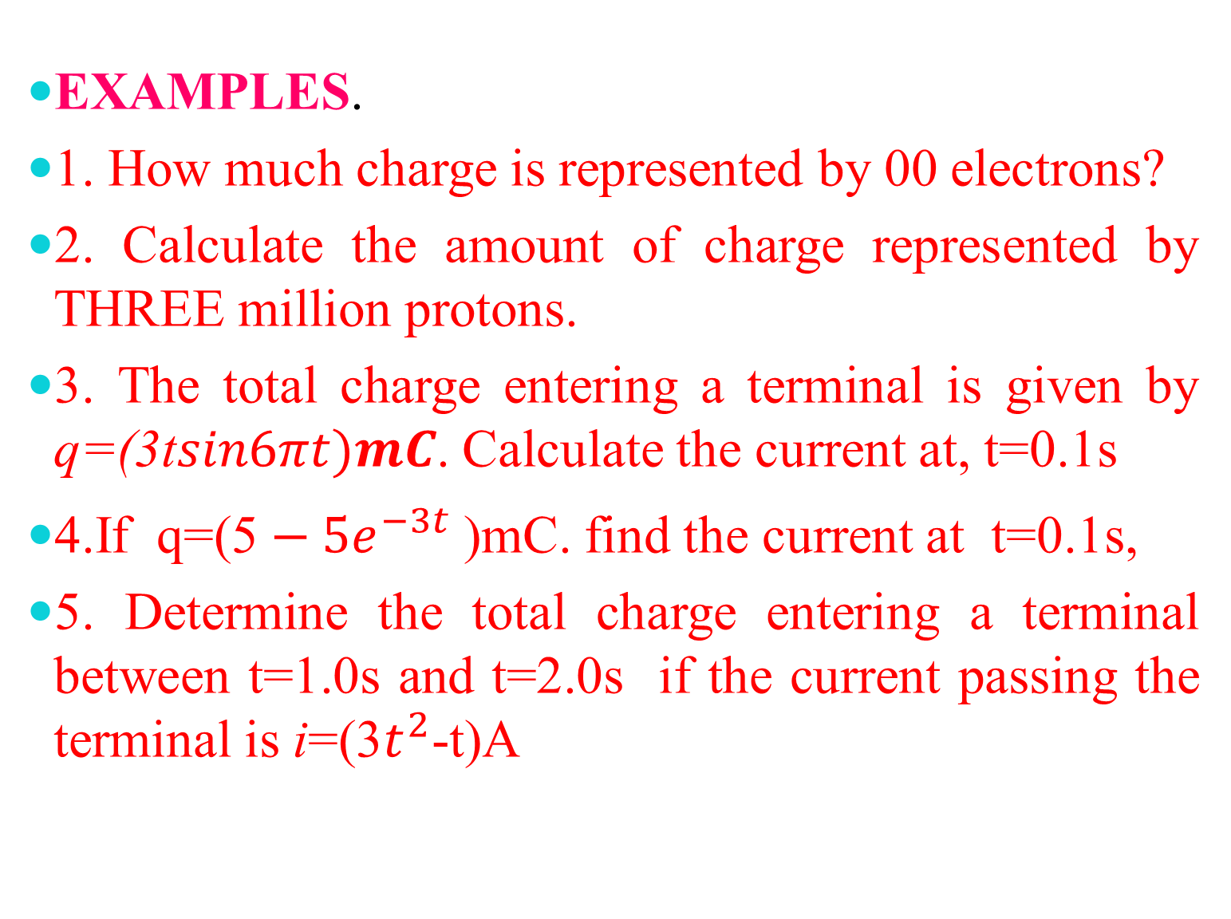
EXAMPLES.
1. How much charge is represented by 00 electrons?
2. Calculate the amount of charge represented by THREE million protons.
3. The total charge entering a terminal is given by q=(3t$sin6πt{)mC}$. Calculate the current at, t=0.1s
4.If q=(5$­−5e^{−3t}$ )mC. find the current at t=0.1s,
5. Determine the total charge entering a terminal between t=1.0s and t=2.0s if the current passing the terminal is i=(3$t^{2}$-t)A

Slide 17
Voltage
To move the electron in a conductor in a particular direction requires some work or energy transfer. This work is performed by an external electromotive force (emf). This emf is also known as voltage or potential difference
By definition, Voltage
(or potential difference) is the energy required to move a unit charge through an element, measured in volts (V)

Slide 18
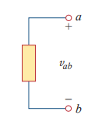
Consider, the voltage across an element (represented by a rectangular block) connected to points a and b. The plus and minus signs are used to define reference direction or voltage polarity.

Slide 19
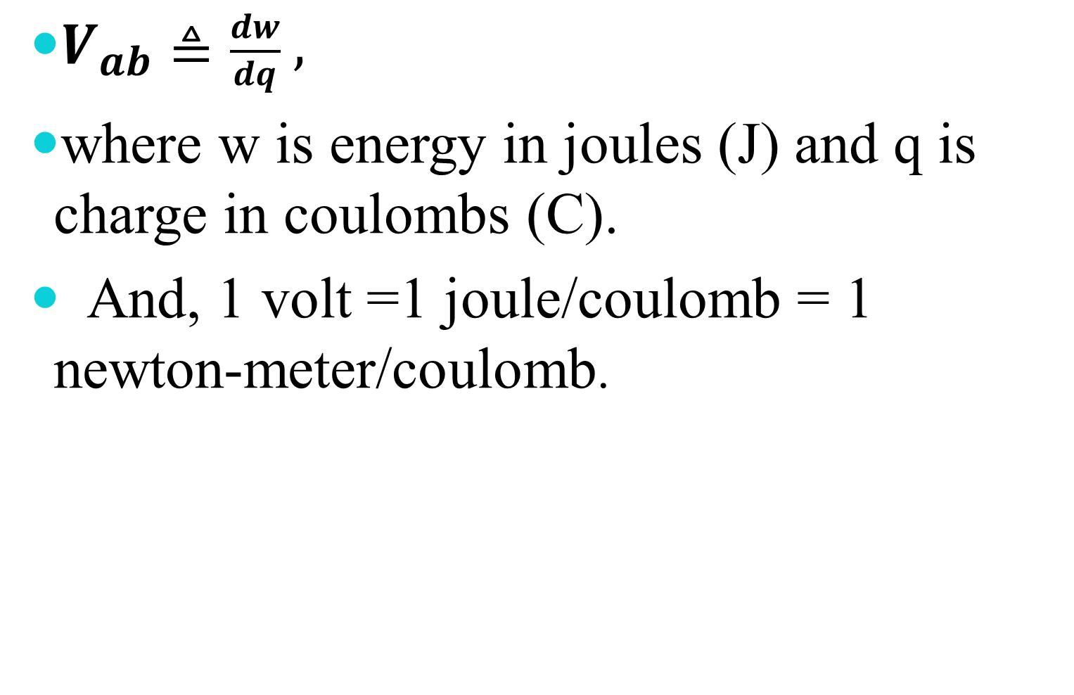
$V_{ab}≜\frac{dw}{dq} ,$
where w is energy in joules (J) and q is charge in coulombs (C).
And, 1 volt =1 joule/coulomb = 1 newton-meter/coulomb.

Slide 20
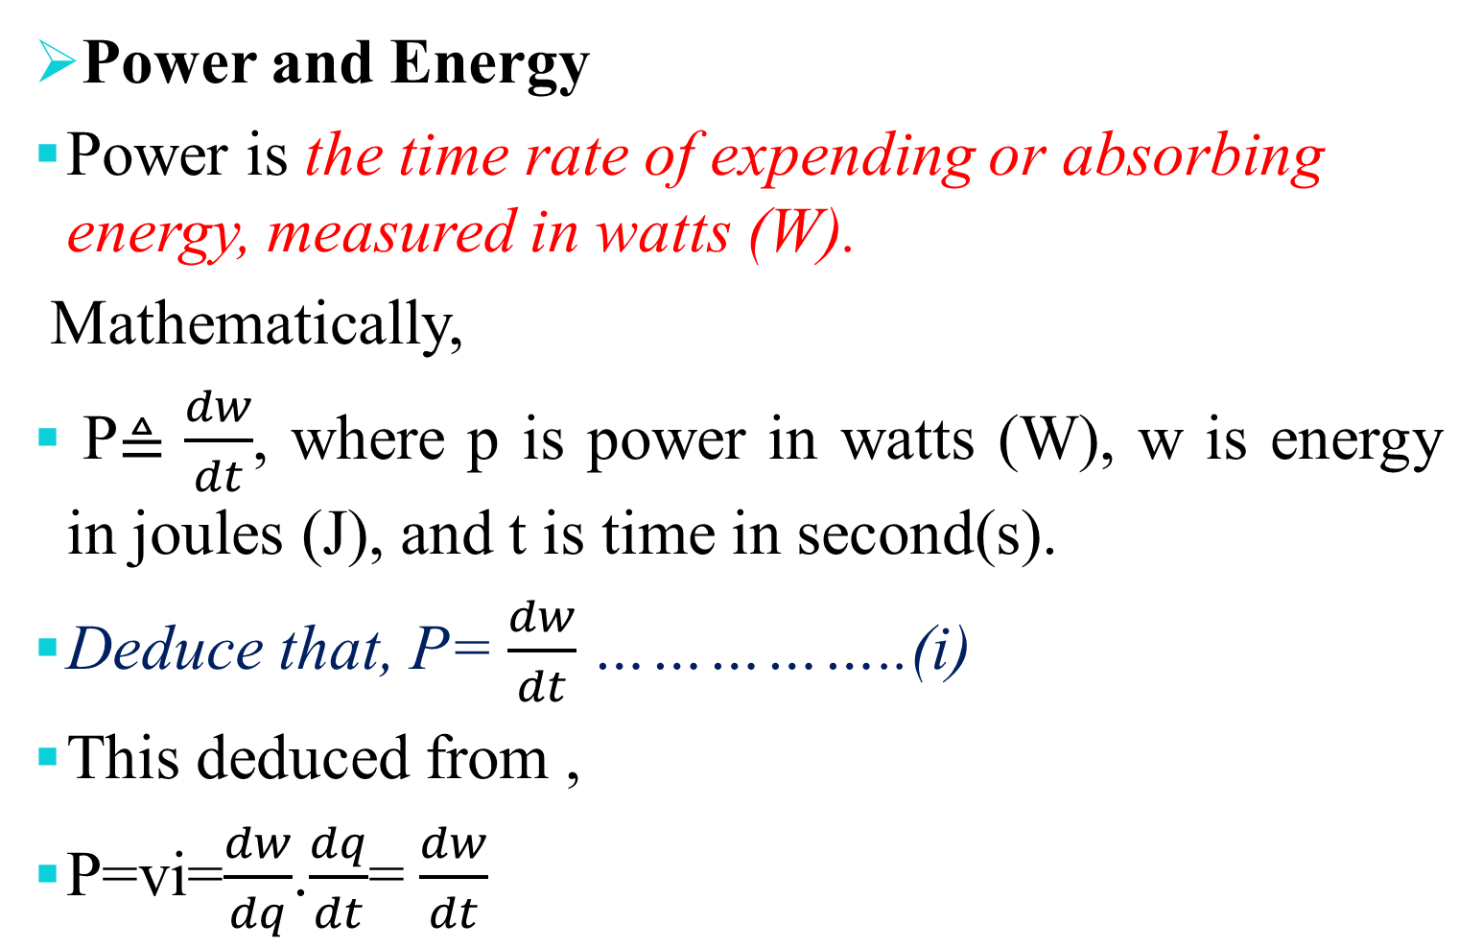
Power and Energy
Power is the time rate of expending or absorbing energy, measured in watts (W).
Mathematically,
P$≜\frac{dw}{dt}$, where p is power in watts (W), w is energy in joules (J), and t is time in second(s).
Deduce that, P= $\frac{dw}{dt}$……………..(i)
This deduced from ,
P$\text{=}\text{vi}$=$\frac{dw}{dq}$.$\frac{dq}{dt}$= $\frac{dw}{dt}$

Slide 21
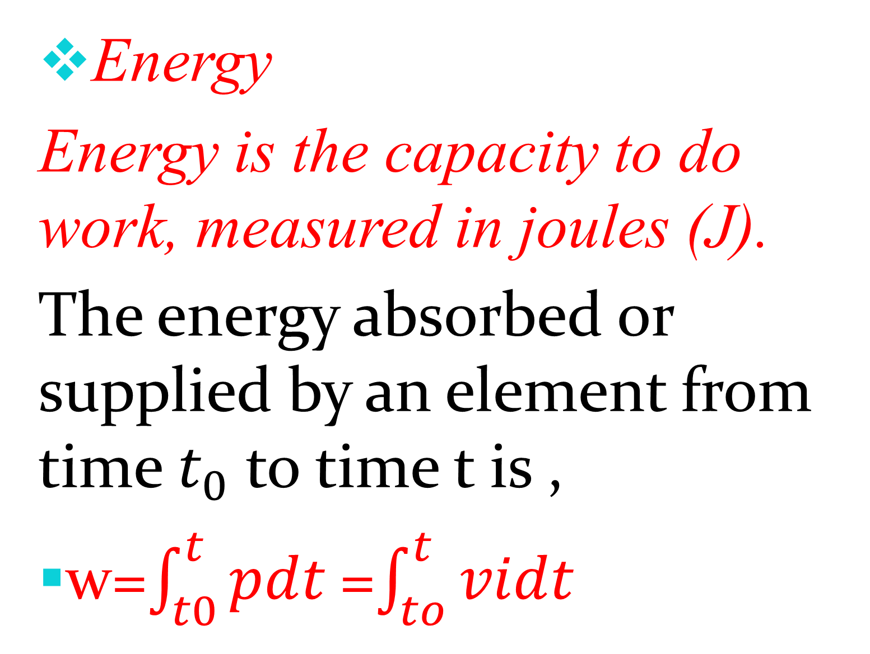
Energy
Energy is the capacity to do work, measured in joules (J).
The energy absorbed or supplied by an element from time $t_{0}$ to time t is ,
w=$\int_{t0}^{t}{pdt }$=$\int_{to}^{t}{vidt}$

Slide 22
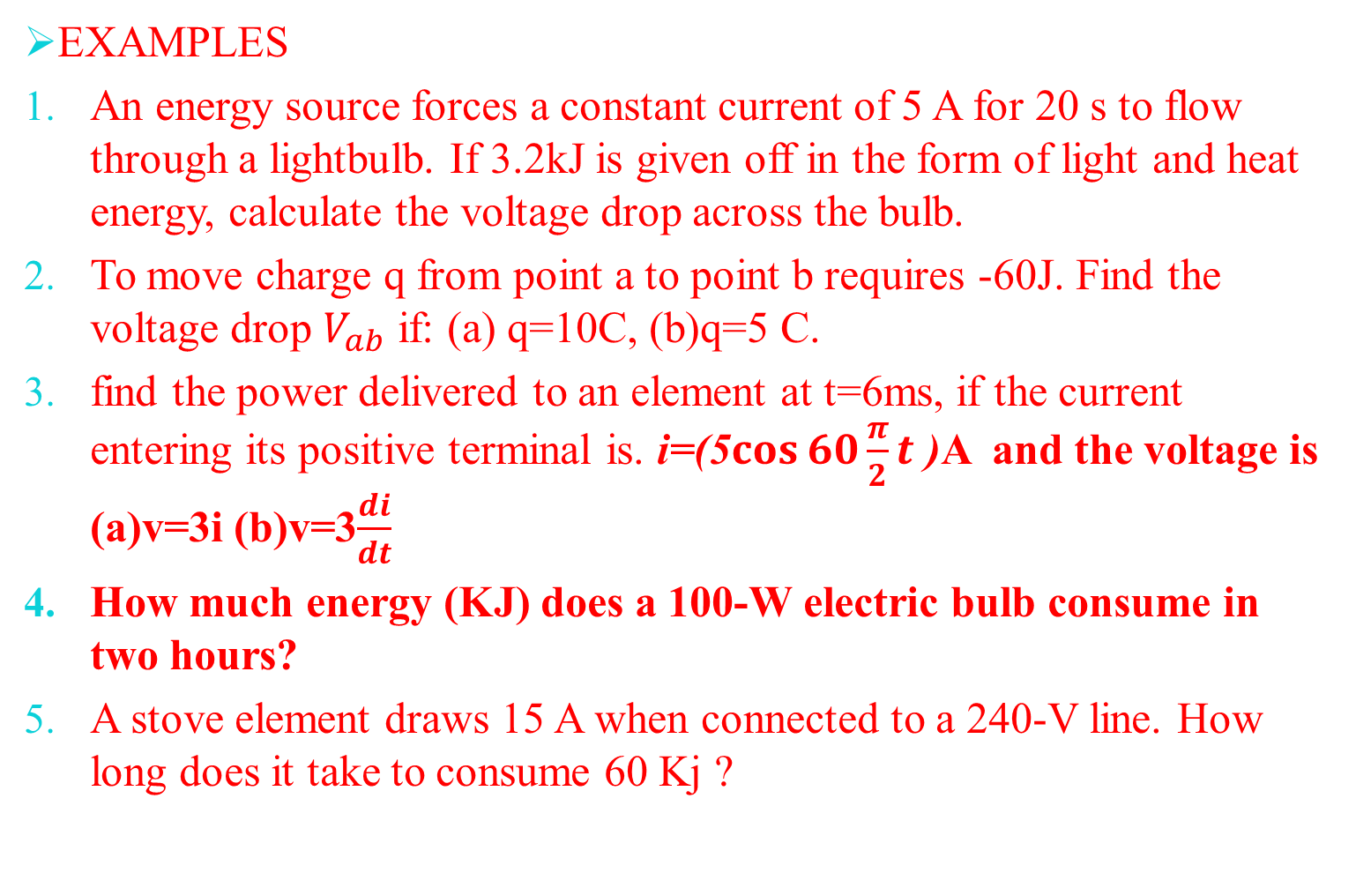
EXAMPLES
An energy source forces a constant current of 5 A for 20 s to flow through a lightbulb. If 3.2kJ is given off in the form of light and heat energy, calculate the voltage drop across the bulb.
To move charge q from point a to point b requires -60J. Find the voltage drop $V_{ab}$ if: (a) q=10C, (b)q=5 C.
find the power delivered to an element at t=6ms, if the current entering its positive terminal is. i=(5$\cos{60\frac{π}{2}t}$ )A and the voltage is (a)v=3i (b)v=3$\frac{di}{dt}$
How much energy (KJ) does a 100-W electric bulb consume in two hours?
A stove element draws 15 A when connected to a 240-V line. How long does it take to consume 60 Kj ?

Slide 23
……THE END OF LECTURE ONE………
…..THANK you………

